Slide 1
Introduction to Machine Learning

Slide 2
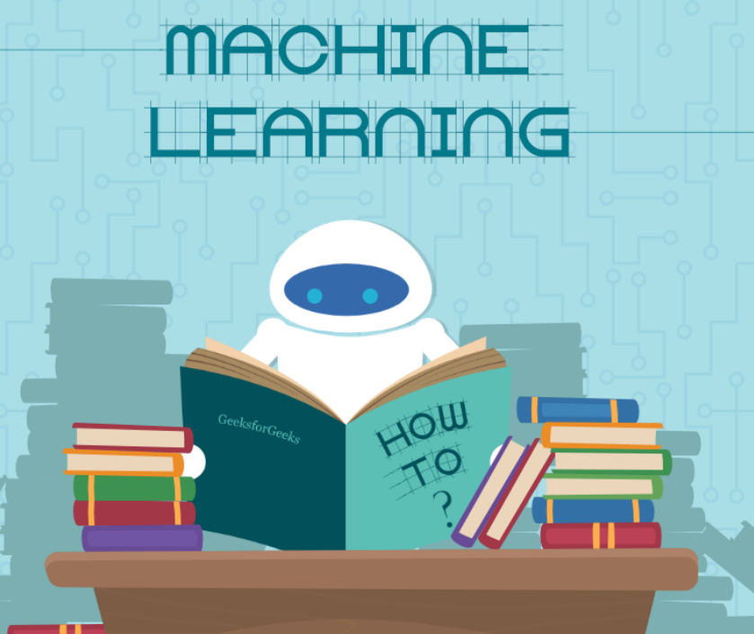
Machine learning
Machine Learning is the field of study that gives computers the capability to learn without being explicitly programmed.
ML is one of the most exciting technologies that one would have ever come across.
As it is evident from the name, it gives the computer that makes it more similar to humans: The ability to learn. Machine learning is actively being used today, perhaps in many more places than one would expect.

Slide 3
Demystifying Machine Learning
Machine Learning : What is it really?
Well, Machine Learning is a subfield of Artificial Intelligence which evolved from Pattern Recognition and Computational Learning theory.
So, basically, the field of Computer Science and Artificial intelligence that “learns” from data without human intervention.
But this view has a flaw. As a result of this perception, whenever the word Machine Learning is thrown around, people usually think of “A.I.” and “Neural Networks that can mimic Human brains ( as of now, that is not possible)”, Self Driving Cars and what not.
But Machine Learning is far beyond that. Below we uncover some expected and some generally not expected facets of Modern Computing where Machine Learning is in action.

Slide 4
Machine Learning: The Expected
Speech Recognition (Natural Language Processing in more technical terms) :
You talk to alexa But how does it understand what you say? Along comes the field of Natural Language Processing, or N.L.P. It deals with the study of interactions between Machines and Humans, via Linguistics.
Guess what is at the heart of NLP: Machine Learning Algorithms and Systems ( Hidden Markov Models being one).
Computer Vision :
Computer Vision is a subfield of AI which deals with a Machine’s (probable) interpretation of the Real World.
In other words, all Facial Recognition, Pattern Recognition, Character Recognition Techniques belong to Computer Vision. And Machine Learning once again, with it wide range of Algorithms, is at the heart of Computer Vision.
Google’s Self Driving Car :
Well. You can imagine what drives it actually. More Machine Learning goodness.

Slide 5
Machine Learning : The Unexpected
Amazon’s Product Recommendations:
Ever wondere how Amazon always has a recommendation that just tempts you to lighten your wallet. Well, that’s a Machine Learning Algorithm(s) called “Recommender Systems” working in the backdrop.
It learns every user’s personal preferences and makes recommendations according to that.
Youtube/Netflix :
They work just as above!
Data Mining / Big Data :
This might not be so much of a shock to many.
But Data Mining and Big Data are just manifestations of studying and learning from data at a larger scale.
And wherever there’s the objective of extracting information from data, you’ll find Machine Learning lurking nearby.

Slide 6
Stock Market/Housing Finance/Real Estate :
All of these fields, incorporate a lot of Machine Learning systems in order to better assess the market, namely “Regression Techniques”, for things as mediocre as predicting the price of a House, to predicting and analyzing stock market trends.

Slide 7
Types of machine learning problems
There are various ways to classify machine learning problems. Here, we discuss the most obvious ones.
On basis of the nature of the learning “signal” or “feedback” available to a learning system
Supervised learning:
The computer is presented with example inputs and their desired outputs, given by a “teacher”, and the goal is to learn a general rule that maps inputs to outputs. The training process continues until the model achieves the desired level of accuracy on the training data. Some real-life examples are:
Image Classification: You train with images/labels. Then in the future you give a new image expecting that the computer will recognize the new object.
Market Prediction/Regression: You train the computer with historical market data and ask the computer to predict the new price in the future.

Slide 8
Unsupervised learning:
No labels are given to the learning algorithm, leaving it on its own to find structure in its input. It is used for clustering population in different groups. Unsupervised learning can be a goal in itself (discovering hidden patterns in data).
Clustering: You ask the computer to separate similar data into clusters, this is essential in research and science.
High Dimension Visualization: Use the computer to help us visualize high dimension data.
Generative Models: After a model captures the probability distribution of your input data, it will be able to generate more data. This can be very useful to make your classifier more robust.

Slide 9
Semi-supervised learning:
Problems where you have a large amount of input data and only some of the data is labeled, are called semi-supervised learning problems.
These problems sit in between both supervised and unsupervised learning. For example, a photo archive where only some of the images are labeled, (e.g. dog, cat, person) and the majority are unlabeled.
Reinforcement learning:
A computer program interacts with a dynamic environment in which it must perform a certain goal (such as driving a vehicle or playing a game against an opponent).
The program is provided feedback in terms of rewards and punishments as it navigates its problem space.

Slide 10
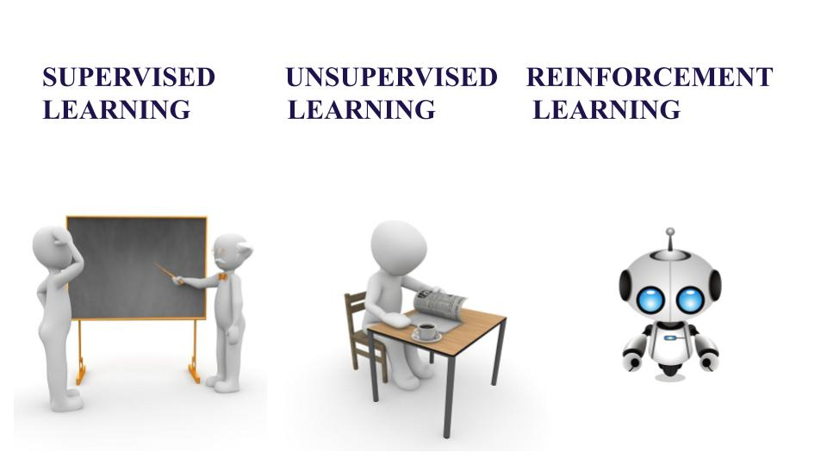

Slide 11
On the basis of “output” desired from a machine learned system
Classification:
Inputs are divided into two or more classes, and the learner must produce a model that assigns unseen inputs to one or more (multi-label classification) of these classes.
This is typically tackled in a supervised way. Spam filtering is an example of classification, where the inputs are email (or other) messages and the classes are “spam” and “not spam”.
Regression:
It is also a supervised learning problem, but the outputs are continuous rather than discrete. For example, predicting the stock prices using historical data.
Clustering:
Here, a set of inputs is to be divided into groups. Unlike in classification, the groups are not known beforehand, making this typically an unsupervised task.

Slide 12
Density estimation:
The task is to find the distribution of inputs in some space.
Dimensionality reduction:
It simplifies inputs by mapping them into a lower-dimensional space.
Topic modeling is a related problem, where a program is given a list of human language documents and is tasked to find out which documents cover similar topics.
On the basis of these machine learning tasks/problems, we have a number of algorithms which are used to accomplish these tasks.
Some commonly used machine learning algorithms are Linear Regression, Logistic Regression, Decision Tree, SVM(Support vector machines), Naive Bayes, KNN(K nearest neighbors), K-Means, Random Forest, etc.

Slide 13
Terminologies of Machine Learning
Model
A model is a specific representation learned from data by applying some machine learning algorithm. A model is also called hypothesis.
Feature
A feature is an individual measurable property of our data. A set of numeric features can be conveniently described by a feature vector. Feature vectors are fed as input to the model. For example, in order to predict a fruit, there may be features like color, smell, taste, etc.
Target (Label)
A target variable or label is the value to be predicted by our model. For the fruit example discussed in the features section, the label with each set of input would be the name of the fruit like apple, orange, banana, etc.

Slide 14
APPLICATIONS
Web Search Engine:
One of the reasons why search engines like google, bing etc work so well is because the system has learnt how to rank pages through a complex learning algorithm.
Photo tagging Applications:
Be it facebook or any other photo tagging application, the ability to tag friends makes it even more happening. It is all possible because of a face recognition algorithm that runs behind the application.
Spam Detector:
Our mail agent like Gmail or Hotmail does a lot of hard work for us in classifying the mails and moving the spam mails to spam folder. This is again achieved by a spam classifier running in the back end of mail application.

Slide 15
Best Python libraries for Machine Learning
In the older days, people used to perform Machine Learning tasks by manually coding all the algorithms and mathematical and statistical formula.
This made the process time consuming, tedious and inefficient.
But in the modern days, it is become very much easy and efficient compared to the olden days by various python libraries, frameworks, and modules.
Today, Python is one of the most popular programming languages for this task and it has replaced many languages in the industry, one of the reason is its vast collection of libraries. Python libraries that used in Machine Learning are:
Numpy
Scipy
Scikit-learn
Theano
TensorFlow
Keras
PyTorch
Pandas
Matplotlib

